Slide 1
The Piano

Slide 2
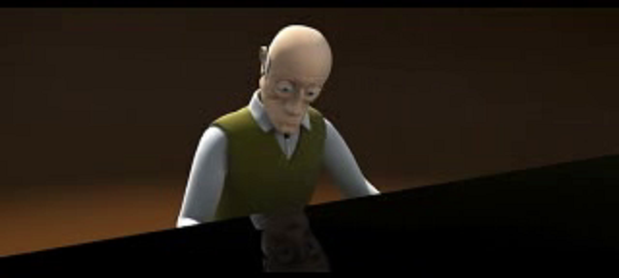
Hot Seating
Work with a partner, think of a question that you would like to ask the old man.

